Slide 1
Homework Assignment #3
Packet Capture and Analyze

Slide 2
Outline
Raw Socket
Socket API
About ioctl
Homework Assignment #3

Slide 3
Raw Socket
Lots of tools or libraries exist for packet capture & analyze
  Sniffer, Pcap,…
However, in this homework, you must utilize the operating system services to capture and analyze packets
  Use ioctl() function to change a NIC’s flag
    Capture all packets passing the NIC
  Use raw socket to obtain layer 2 & layer 3 information
    Analyze all captured packets

Slide 4
Raw Socket
Usually, sockets are used to build applications on top of a transport protocol
  Stream sockets (TCP) and Datagram sockets (UDP)
Some applications need to access a lower layer protocol
Using RAW socket, the packets you receiving are not modified
Constrain
  No port number: system forward raw packets to suitable raw socket
  In Linux, raw socket can only be used by root

Slide 5
Outline
Raw Socket
Socket API
About ioctl
Homework Assignment #3

Slide 6
Socket API (cont.)
socket
  Create a descriptor for use in network communication
#include <sys/type.h>
#include <sys/socket.h>
int socket(int domain, int type, int protocol);
EX: fd=socket(PF_PACKET,SOCK_RAW,htons(ETH_P_ALL));
domain:
PF_UNIX: Protocol Family is UNIX
(for local communication)
PF_INET: Protocol Family is IPv4
PF_INET6:Protocol Family is IPv6
type:
SOCK_STREAM: TCP
SOCK_DGRAM: UDP
SOCK_SEQPACKET: SCTP
SOCK_RAW
protocol:
0 ~ 255
  (ref. /etc/protocols. The value 0 may be used to select a default protocol from the selected domain and type)
  htons(ETH_P_ALL) : all protocols are received
return value:
successful:
    return a non-negative integer, socket descriptor (sd)
otherwise return -1

Slide 7
Socket API (cont.)
htons
  Convert the unsigned short integer hostshort from host byte order to network byte order
htonl
  Convert the unsigned integer hostlong from host byte order to network byte order
#include <arpa/inet.h>
uint16_t htons(uint16_t hostshort);
EX: address.sin_port = htons(5555);
#include <arpa/inet.h>
uint32_t htonl(uint32_t hostlong);
EX: address.sin_addr.s_addr = htonl(0x7F000001);

Slide 8
Socket API (cont.)
bzero
  Set the first n bytes of the area starting at s to zero (bytes containing '\0')
inet_addr
  Convert the Internet host address cp from IPv4 numbers-and-dots notation into binary data in network byte order
#include <string.h>
void bzero(char *s, int n);
EX: bzero(&Address, sizeof(Address));
#include <sys/socket.h>
#include <netinet/in.h>
#include <arpa/inet.h>
in_addr_t inet_addr(const char *cp);
EX: address.sin_addr.s_addr = inet_addr(“140.120.15.242”);

Slide 9
Socket API (cont.)
bind
  Bind a local IP address and protocol port to a socket
#include <sys/socket.h>
#include <netinet/in.h>
int bind(int sd, struct sockaddr *address, int address_length);
EX:
struct sockaddr_in Address;
bind(sock,(struct sockaddr *)&Address, sizeof(Address))

Slide 10
Socket API (cont.)
recvfrom
  Receive a message from a socket
sendto
  Send a message on a socket
#include <sys/socket.h>
int recvfrom(int sd, void *buffer, int message_length, int flags,
struct sockaddr *address, int *address_length);
EX: byte_recv = recvfrom(sock, buffer, sizeof(buffer), 0, (struct sockaddr *)&Address, &sizeof(Address));
#include <sys/socket.h>
int sendto(int sd, void *buffer, int message_length, int flags,
struct sockaddr *address, int address_length);
EX: byte_sent = sendto(sock, buffer, sizeof(buffer), 0, (struct sockaddr *)&Address, sizeof(Address));

Slide 11
Socket API (cont.)
close
  Terminate communication and deallocate a descriptor
#include <unistd.h>
int close(int sd);
EX: close(sock);

Slide 12
Outline
Raw Socket
Socket API
About ioctl()
Homework Assignment #3

Slide 13
About ioctl()
Ioctl()
  Manipulates the underlying device parameters of special files
#include <sys/ioctl.h>
int ioctl(int fd, unsigned long com, char *argp)
EX: ioctl(fd,SIOCGIFFLAGS, *ifreq );
Command | Third argument | Description
SIOCGIFCONF | struct ifconf * | Retrieve list of interface configuration
SIOCGIFFLAGS | struct ifreq * | Get interface flags
SIOCGIFMETRIC | struct ifreq * | Get interface metric
SIOCSIFFLAGS | struct ifreq * | Set interface flags
SIOCSIFMETRIC | struct ifreq * | Set interface metric

Slide 14
About ioctl() (cont.)
struct ifreq
{
char ifr_name[IFNAMSIZ]; /* Interface name */
union {
struct sockaddr ifr_addr;
struct sockaddr ifr_dstaddr;
struct sockaddr ifr_broadaddr;
struct sockaddr ifr_netmask;
struct sockaddr ifr_hwaddr;
short ifr_flags;
int ifr_ifindex;
int ifr_metric;
int ifr_mtu;
struct ifmap ifr_map;
char ifr_slave[IFNAMSIZ];
char ifr_newname[IFNAMSIZ];
char * ifr_data;
};
}

Slide 15
About ioctl() (cont.)
SIOCGIFFLAGS, SIOCSIFFLAGS
  Get or set the active flag word of the device
contains a bit mask of the following values:
Device flags
IFF_UP Interface is running.
IFF_BROADCAST Valid broadcast address set.
IFF_DEBUG Internal debugging flag.
IFF_LOOPBACK Interface is a loopback interface.
IFF_POINTOPOINT Interface is a point-to-point link.
IFF_RUNNING Resources allocated.
IFF_NOARP No arp protocol, L2 destination address not set.
IFF_PROMISC Interface is in promiscuous mode.
IFF_NOTRAILERS Avoid use of trailers.
IFF_ALLMULTI Receive all multicast packets.
IFF_MASTER Master of a load balancing bundle.
IFF_SLAVE Slave of a load balancing bundle.
IFF_MULTICAST Supports multicast
IFF_PORTSEL Is able to select media type via ifmap.
IFF_AUTOMEDIA Auto media selection active.
IFF_DYNAMIC The addresses are lost when the interface goes down.
IFF_LOWER_UP Driver signals L1 up (since Linux 2.6.17)
IFF_DORMANT Driver signals dormant (since Linux 2.6.17)
IFF_ECHO Echo sent packets (since Linux 2.6.25)

Slide 16
Outline
Raw Socket
Socket API
About ioctl
Homework Assignment #3

Slide 17
Homework Assignments #3
Basic:
  Capture and analyze some packets’ information (70 pts)
Advanced: (30 pts)
  Write a program that fake your IP address and send the packet
  Write a program that fake your IP address, modify the payload and send the packet

Slide 18
Homework Assignment #3 Basic: (70 pts)
    In this work, you are asked to use raw socket to obtain layer 2 & layer 3 information and analyze all captured packets
  HW3-1 (20 pts)
    Write a program that capture 100 packets and analyze
  HW3-2 (25 pts)
    Write a program that capture 10 UDP packets
      Destination belongs to you
      Print out the information of packets
  HW3-3 (25 pts)
    Write a program that capture 10 TCP packets
      Source and destination not belong to you
      Print out the information of packets

Slide 19
Flowchart
Start
struct ifreq ethreq;
//ifreq in <net/if.h>
unsigned char buffer[ETH_FRAME_LEN];
//frame could be placed at this buffer
Setup
interface
Header:
#include <sys/types.h>
#include <sys/socket.h>
Define:
int socket(int domain,int type,int protocol)
You need defining a Raw Socket to get L2,L3 information.
Ex: fd=socket(PF_PACKET,SOCK_RAW,htons(ETH_P_ALL));
Establish
socket
Header:
#include <sys/ioctl.h>
Define:
int ioctl(int fd, unsigned long com, char *argp)
Using command SIOCGIFFLAGS to get the original flag
EX:
strncpy(ethreq.ifr_name,"eth0",IFNAMSIZ);
ioctl(fd,SIOCGIFFLAGS,&ethreq);
Get
interface
flag

Slide 20
Flowchart (cont.)
Define in header file “if.h”
#define IFF_PROMISC 0x100 /*receive all packets */
You need to set NIC’s flag to IFF_PROMISC
EX:
ethreq.ifr_flags|=IFF_PROMISC;
ioctl(fd,SIOCSIFFLAGS,&ethreq);
P.S. before program terminated, remember to restore NIC’s flag -- ethreq.ifr_flags&=~IFF_PROMISC;
Set
promiscuous
mode
EX:
recvfrom(fd, buffer, ETH_FRAME_LEN, 0, NULL, NULL);
Receive
packets
IP
ARP
Others
….
Analyzing
&
Filtering
TCP
UDP
ICMP
….
Loop
receive

Slide 21
Data Structure
Define structure
  #include <linux/if_ether.h> //for ethernet header
    struct ether_header
    {
    unsigned char ether_dhost[ETH_ALEN];
    unsigned char ether_shost[ETH_ALEN];
    unsigned short ether_type;
    }
  #include <linux/ip.h> //for IP header
  struct iphdr {
    unsigned int version:4;
    unsigned int h_len:4;
    unsigned char tos;
    unsigned short total_len;
    unsigned short ident;
    unsigned short frag_and_flags;
    unsigned char ttl;
    unsigned char proto;
    unsigned short checksum;
    unsigned int sourceIP;
    unsigned int destIP;
    }

Slide 22
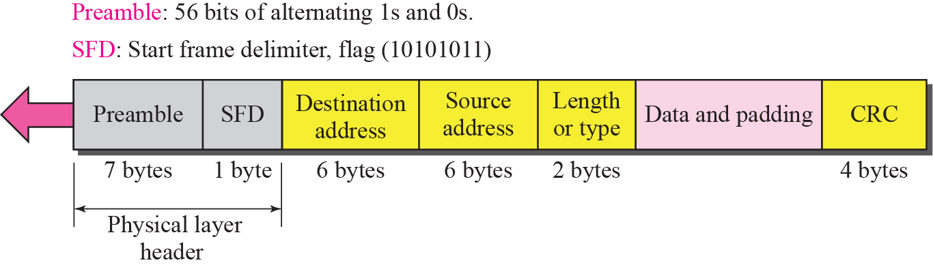
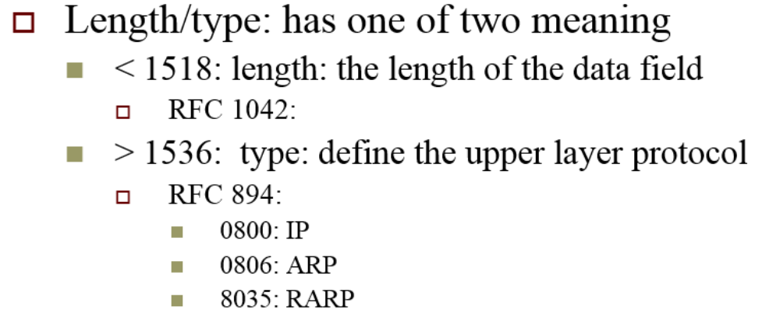
Ethernet Frame Analysis
If length/type is greater than 1536, then PDU means the protocol used by “Data and Padding”.

Slide 23
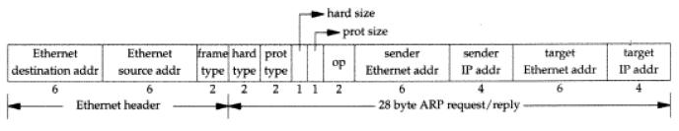
ARP/RARP Packet Analysis
ARP and RARP have same format.
If frame type is 0x0806, data and padding is ARP
If frame type is 0x8035, data and padding is RARP

Slide 24
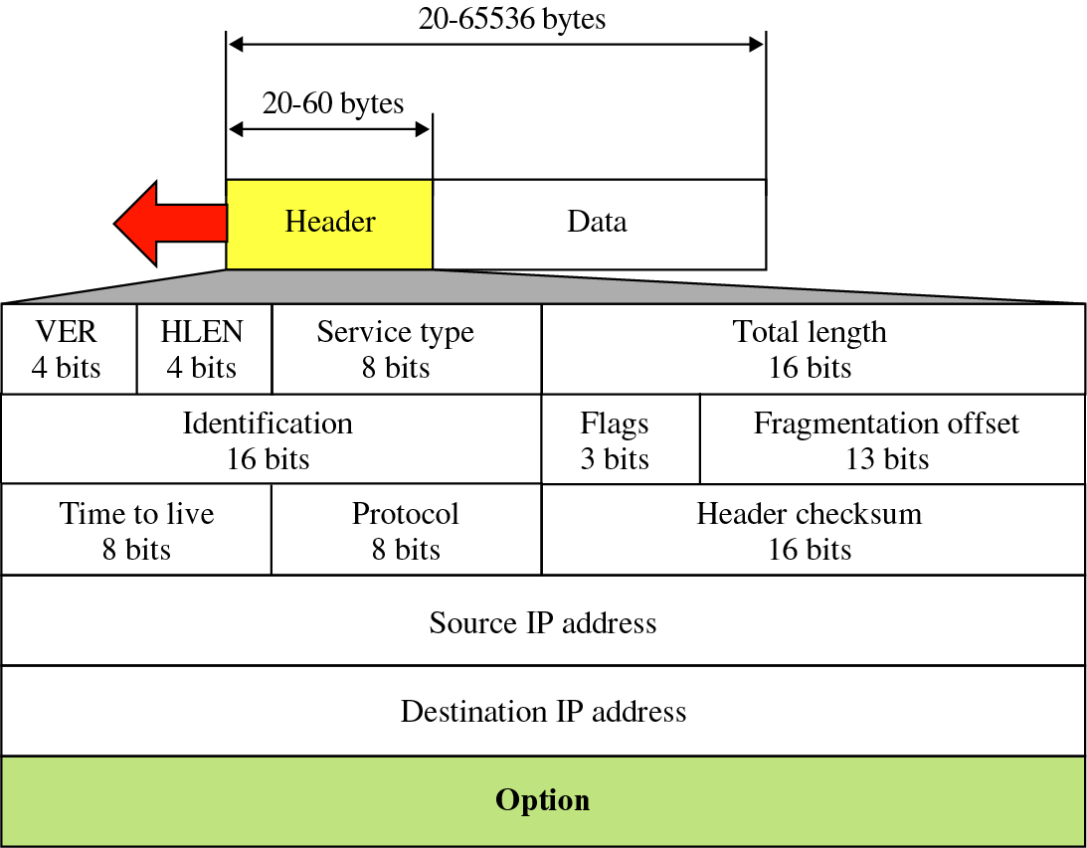
IP Packet Analysis
If type is 0x0800, data and padding is IP packet
Protocol could be 1(ICMP), 2(IGMP), 6(TCP), 7(UDP).

Slide 25
int main(int argc, char *argv[]){
  struct ether_header *peth;
  struct iphdr *pip;
  char *ptemp;
  .....
  struct ifreq ifr;
  strncpy(ifr.ifr_name, "eth0", 5);
  if(ioctl(sock,SIOCGIFFLAGS,&ifr) == -1)
  {
  perror("ioctl");exit(1);
  }
  ifr.ifr_flags |= IFF_PROMISC;
  if(ioctl(sock, SIOCSIFFLAGS, &ifr) == -1)
  {
  perror("ioctl");exit(3);
  }
}

Slide 26
for(;;)
{
r = recvfrom(sock, (char *)buf, sizeof(buf), 0, (struct sockaddr *)&addr, &len);
ptemp = buf;
peth = (struct ether_header *)ptemp; //ethernet header
switch(ntohs(peth->ether_type))
{
case 0x0800:
ip_counter++;
break;
case 0x0806:
arp_counter++;
break;
case 0x8035:
rarp_counter++;
break;
}

Slide 27
ptemp += sizeof(struct ether_header);
pip = (struct ip *)ptemp;
switch(pip->protocol)
{
case IPPROTO_TCP:
ptcp = (struct tcphdr *)ptemp; tcp_counter++;
break;
case IPPROTO_UDP:
pudp = (struct udphdr *)ptemp;
udp_counter++;
break;
.
.
.

Slide 28
Exercise 3-1 (20 pts)
  Capture 100 packets and print out a summary of the packets
Format: ./capture
ex:
$ ./capture
  ------statistics------
  IP :75
  ARP :3
  RARP :3
  TCP :6
  UDP :60
  ICMP :0
  IGMP :0
  -----finish-----

Slide 29
Exercise 3-2 (25 pts)
Capture 10 UDP packets
  Print out the information for each captured packet
  Destination belongs to you
Format:
    Source MAC address: 00:0E:6A:D3:B3:1E
    Destination MAC address: 00:E0:18:ED:D7:13
    IP->protocol = UDP
    IP->src_ip = 220.130.208.127
    IP->dst_ip = 220.130.208.128

Slide 30
Exercise 3-3 (25 pts)
Capture 10 TCP packets
  Sorce and destination not belong to you
  Print out the information of packets
Format:
    Source MAC address: 00:0E:6A:D3:B3:1E
    Destination MAC address: 00:E0:18:ED:D7:13
    IP->protocol = TCP
    IP->src_ip = 220.130.208.127
    IP->dst_ip = 220.130.208.129
    Src_port =2345
    Dst_port =64

Slide 31
Homework Assignment #3: Advanced (30 pts)
    In this work, you are asked to use raw socket to fake some specified fields in packets
  HW3-4 (15 pts)
    Write a program that fake your IP address and send the packet
      Such as IP spoof attack
  HW3-5 (15 pts)
    Write a program that fake your IP address, modify the payload and send the packet

Slide 32
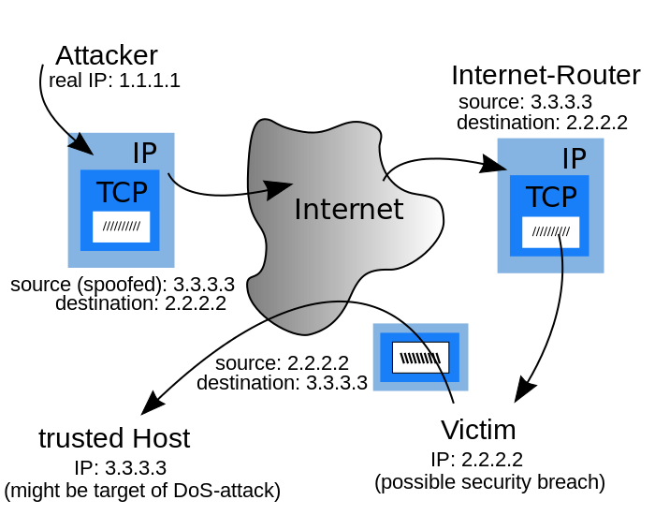
IP Spoof Attack

Slide 33
IP Spoof Attack
  You need to fake an ip address and send 1000 packets to any other real ip address.
Format
  Ex: sudo ./spoof.out <fake address> <real address>
Then, you need to check those fake packets by two methods.
  Use linux instruction
    tcpdump –i lo –nn
  Use wireshark to listen packets
  Use basic part program to observe packets

Slide 34
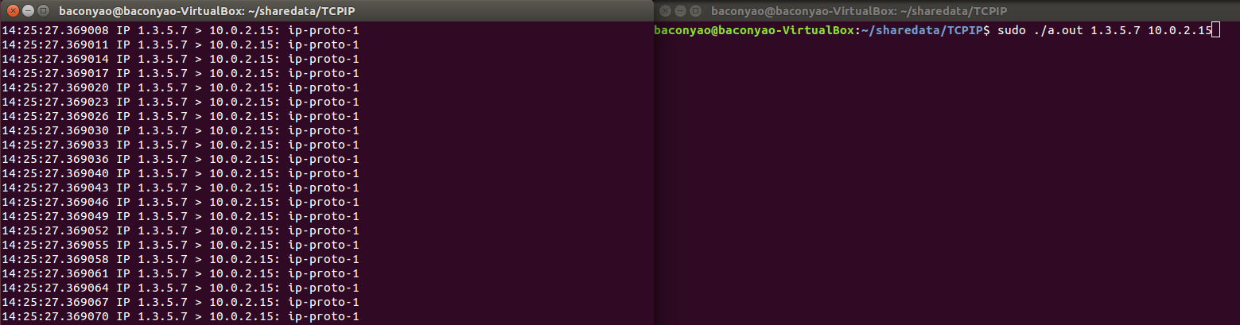
Ex: Use tcpdump
  sudo ./a.out 1.3.5.7 10.0.2.15
Fake address

Slide 35
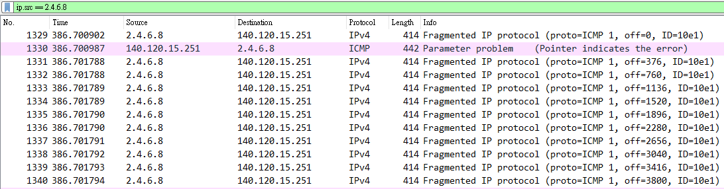
Ex: Use wireshark
  sudo ./a.out 2.4.6.8 140.120.15.251
Fake address

Slide 36
Turn in
Deadline
2017/12/19 11:59:59 PM
Upload to i-learning
File name
  HW3_ID.zip (e.g. HW1_7103056042.zip)
    Source code
    Word
If you want to update
  HW3_ID_New1.zip, HW3_ID_New2.zip….etc
If you don’t hand in your homework on time, your score will be deducted 10 points every day.

Slide 37
TA
Name: PeiYao Chang (張培堯)
Email: bacon735392@gmail.com
  Title format: TCP/IP HW# - [your name]
Lab: OSNET(1003A)

Slide 38
Ref
http://blog.roodo.com/thinkingmore/archives/554037.html
https://wirelessr.gitbooks.io/working-life/content/sockraw_with_tcpdump.html
http://www.tenouk.com/Module43a.html

Slide 39

ANY QUESTION?

